Slide 1


Patch TRIP
2022

Slide 2

JOURNEY
our

Slide 3

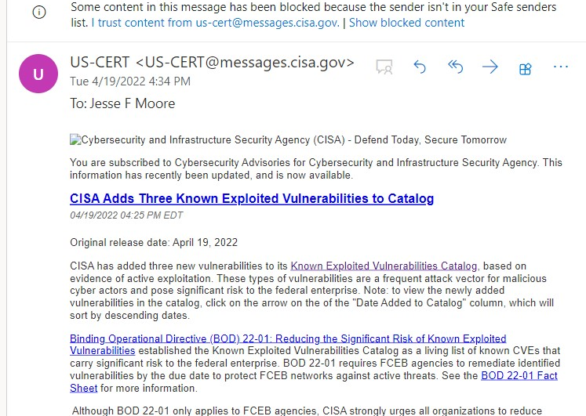
Ugh, CISA Adds more Known CVEs to the “MUST PATCH” list!

Slide 4
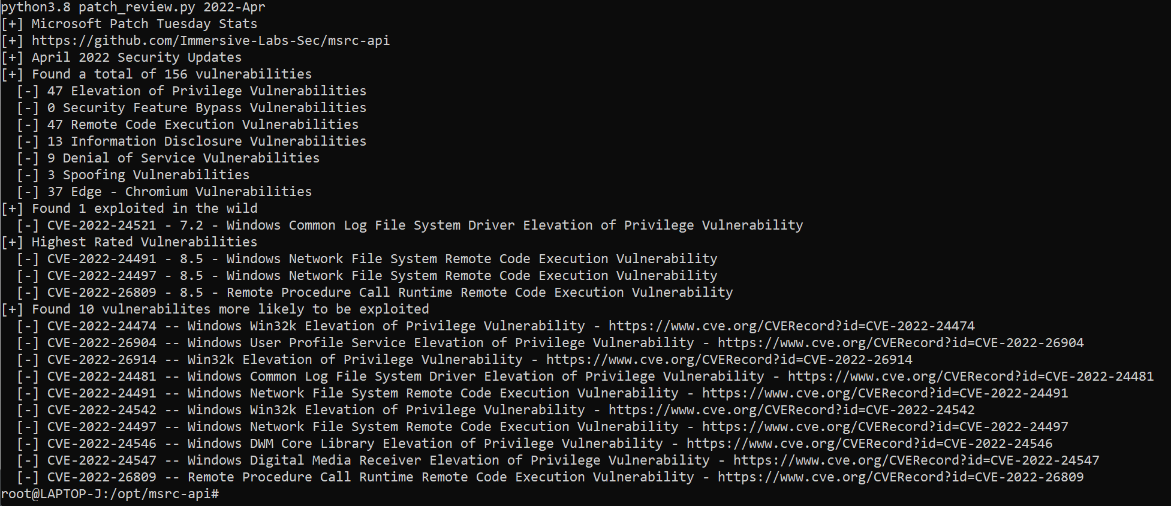
git clone https://github.com/Immersive-Labs-Sec/msrc-api.git
Notes:
python3.8 patch_review.py 2022-Apr

Slide 5



Go Patch all the things! SCCM/MECM 3rd Party, Ninite, Chocolatey, PatchMyPC, Ansible, Auto update, Puppet, CFEngine, Salt, Packer, etc.

Slide 6
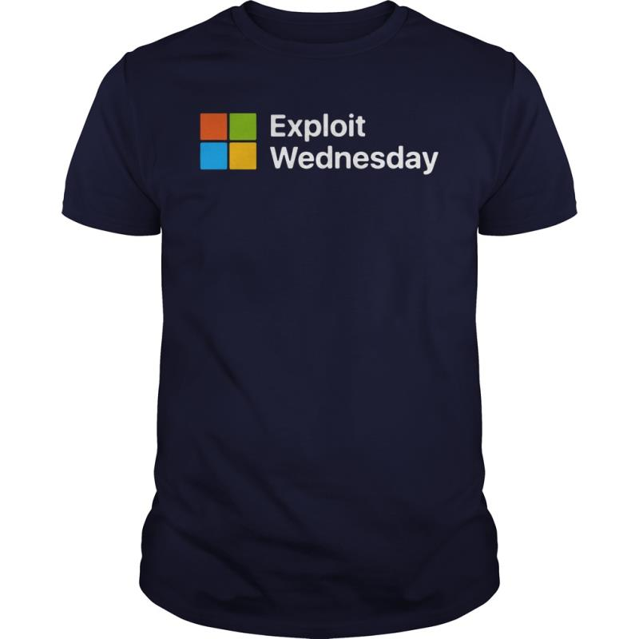
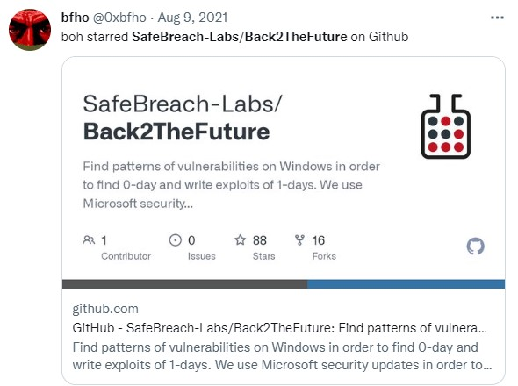
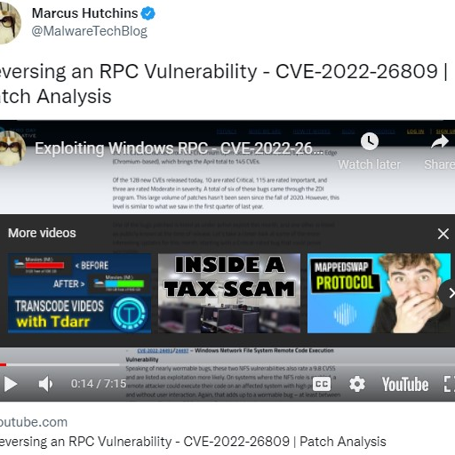
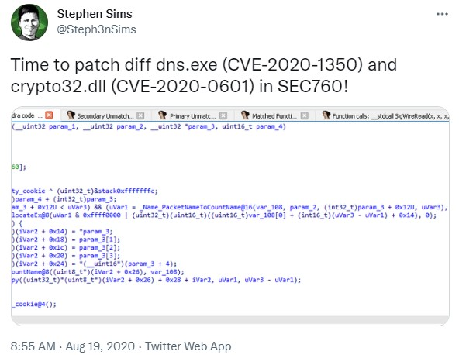
Road
Exploit
Regular Scheduled Patching for all systems (iOT, OS, Switches, Firewalls, Routers, OT, Workstations, Servers, etc.)
Notes:
(193) Exploiting Windows RPC - CVE-2022-26809 Explained | Patch Analysis – YouTube

Slide 7
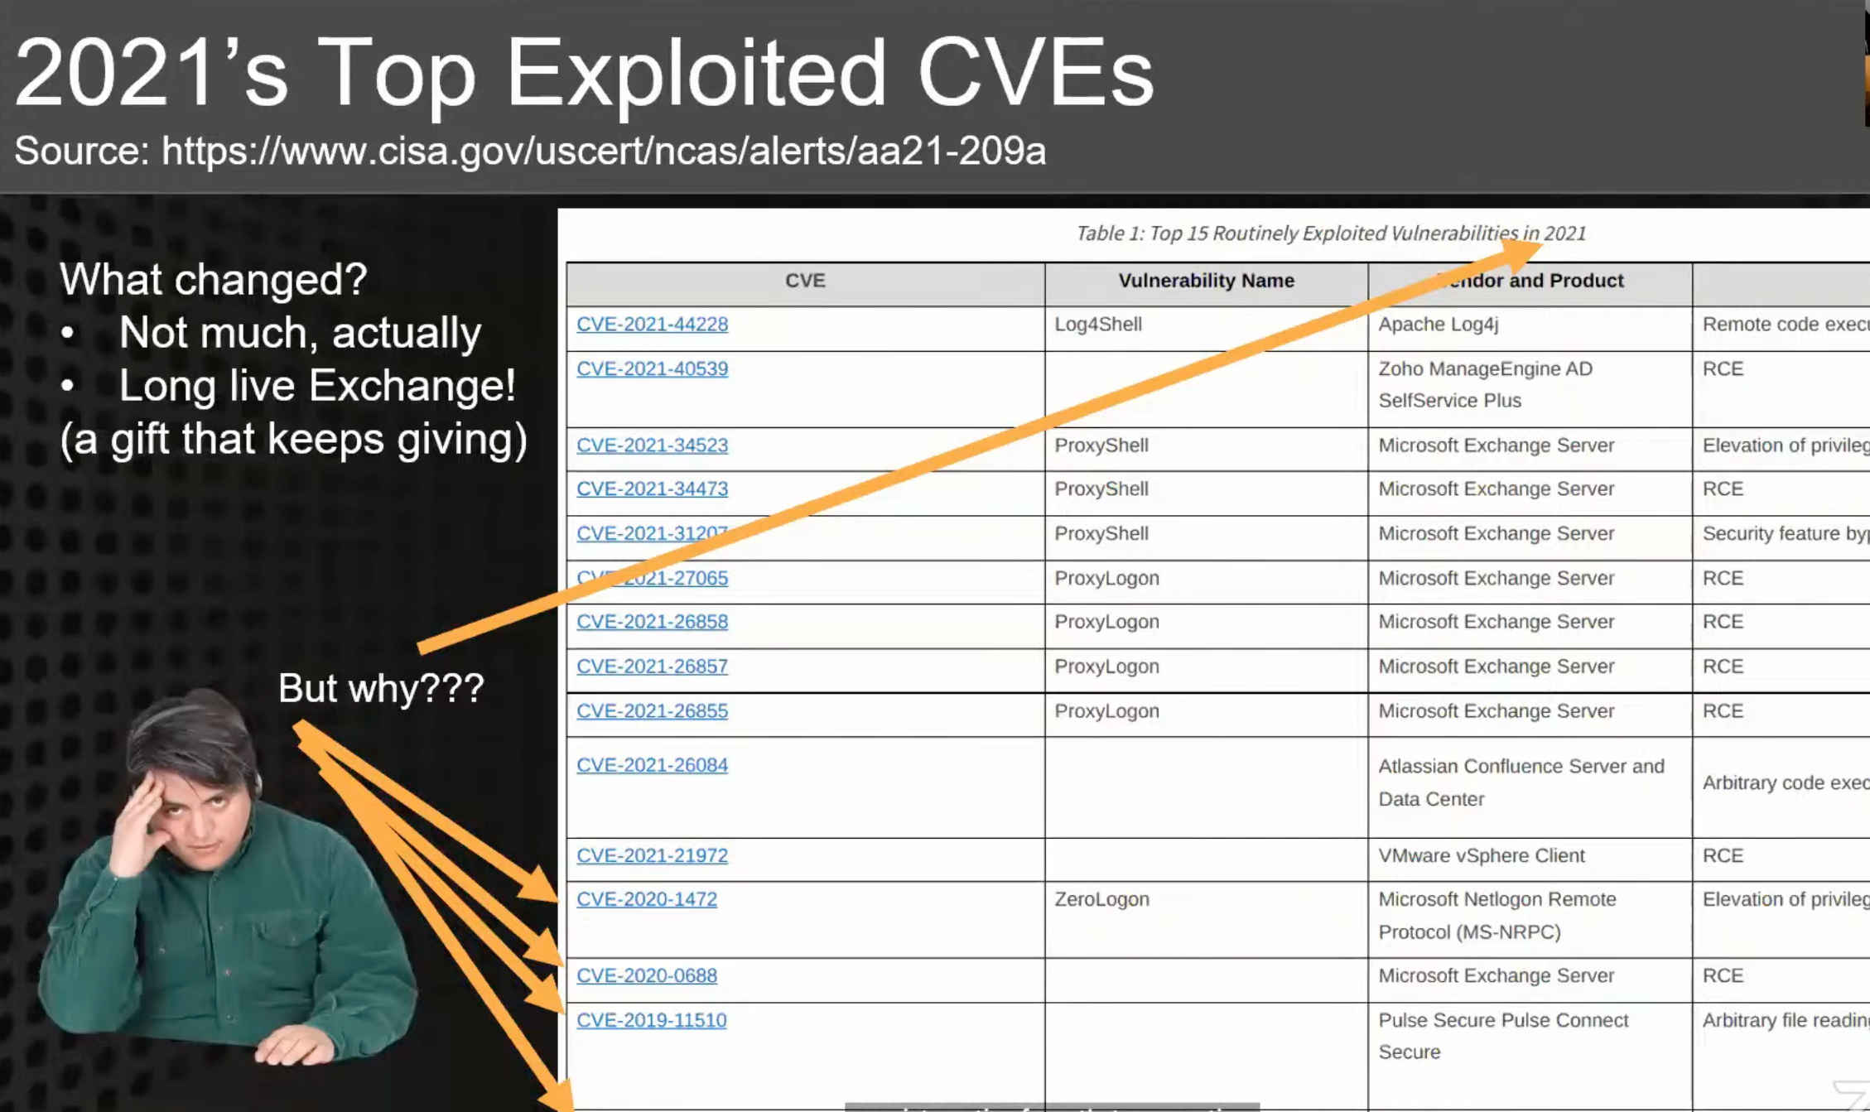

Slide 8
PATCH it ALL
Not just what’s in CISA KEV Catalog
Notes:
Control Validation Compass - Home (controlcompass.github.io)
GPO
ASR – Attack Surface Reduction Rules
AppLocker to block LOLB
EDR such as Sophos
https://blog.0patch.com/2022/06/microsoft-diagnostic-tools-dogwalk.html
Win Defender AV Signatures

Slide 9
Zero days
No time for
Notes:
EOL, and exposed to the Internet

Slide 10
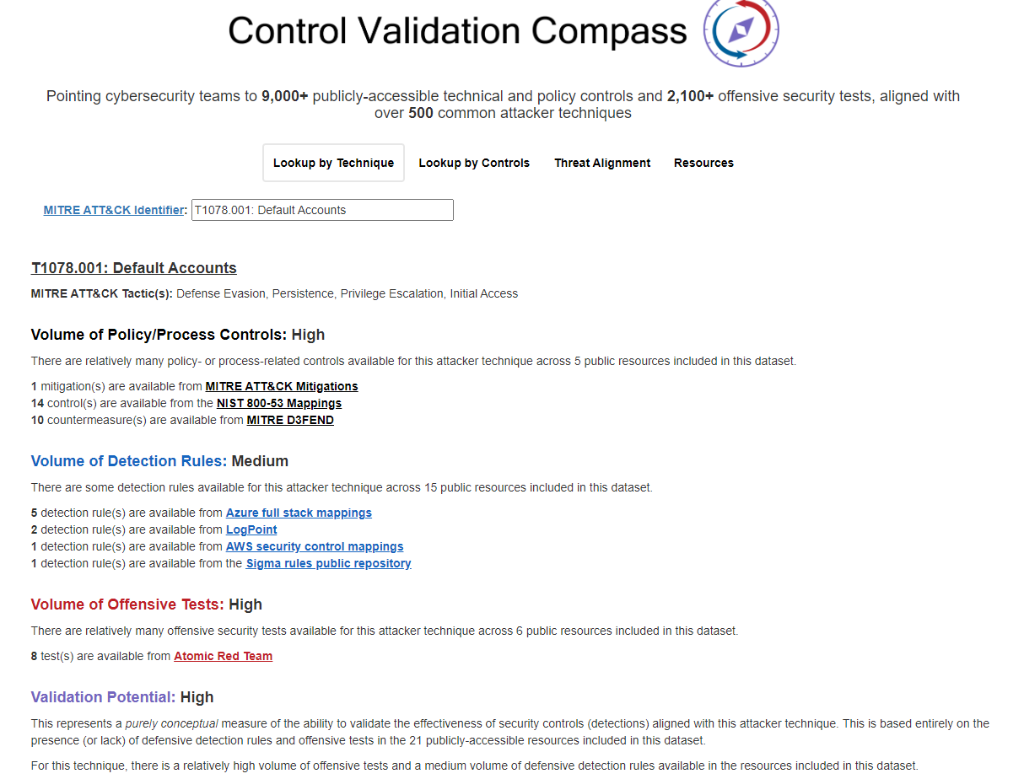
https://controlcompass.github.io
Notes:
Control Validation: Using MITRE Technique
Control Validation Compass - Home (controlcompass.github.io)
Detection: Uncoder.IO | Universal Sigma Rule Converter for SIEM, EDR, and NTDR

